Slide 1




Agentic AI with watsonx and ABP
#let’s create
watsonx Orchestrate

Slide 2

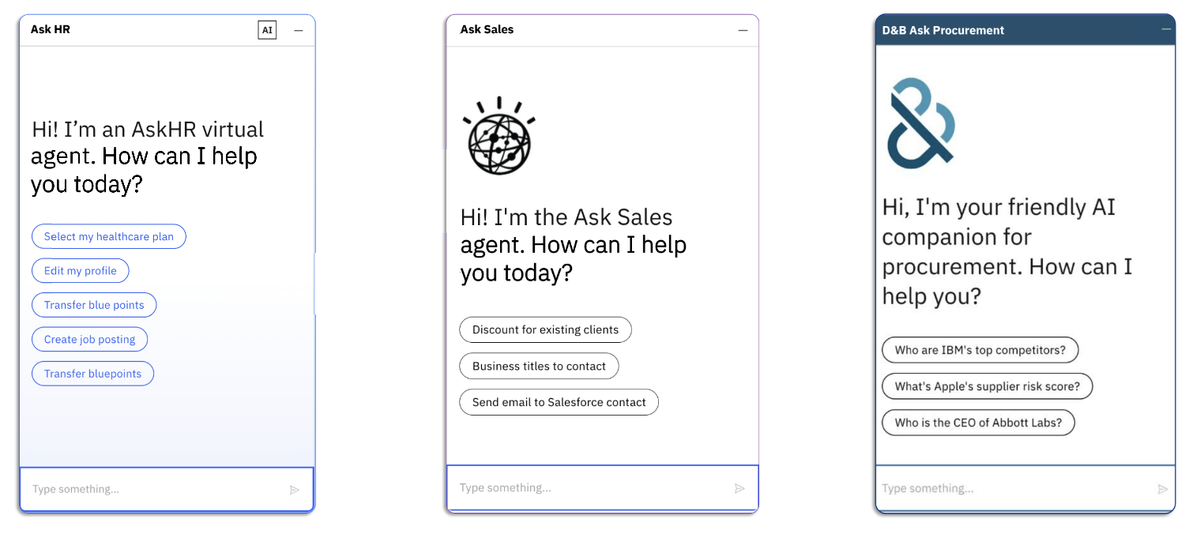
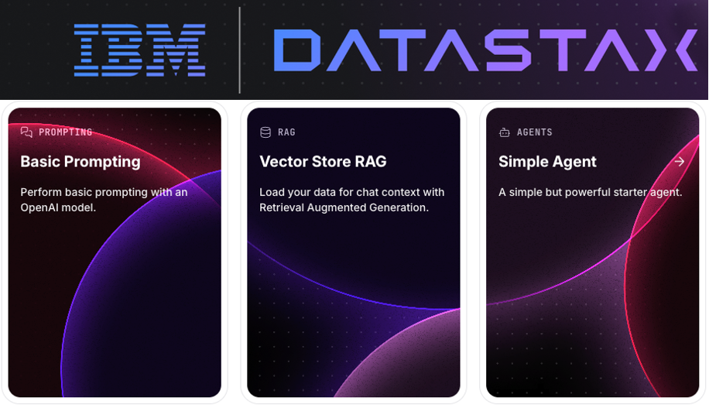














watsonx Orchestrate
Prebuilt IBM’s Agents
Build your own Agent
HR Sales Procurement
External Partner’s Agents & Tools
Agentforce
Compensation agent
Support Analysis Agent
Salesforce SDR Agent
watsonx
Granite

Slide 3
Agenda & Use Case
- Orchestrate Introduction
- Developing Custom Agents
1) Enterprise Policy Agent. Orchestrate UI.
2) Travel Planning Agent. LangFlow + MCP Server.
3) HR Agent as a Supervisor.

Slide 4
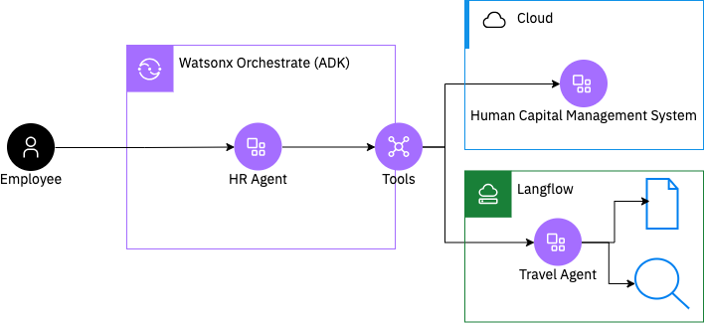

Today’s use-case: Travel + HR agents

Slide 5

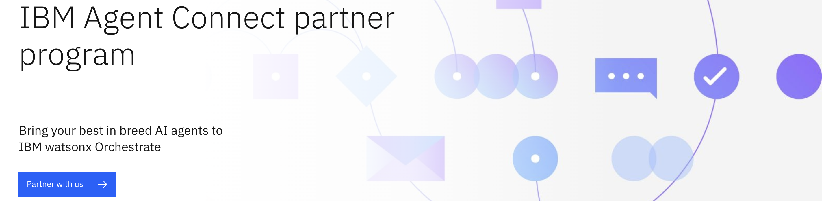
Build Agent & Connect

